Slide 1
Hashable Objects

Slide 2
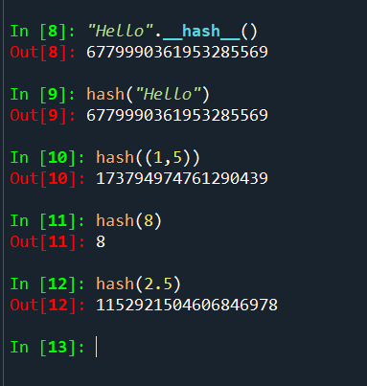
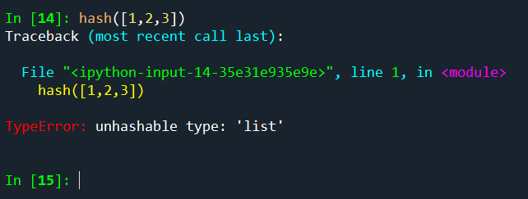
Hash functions
A hash function takes a key and returns an integer
Most classes in Python implement the __hash__ (hash) method that does this for hashable objects of that class

Slide 3
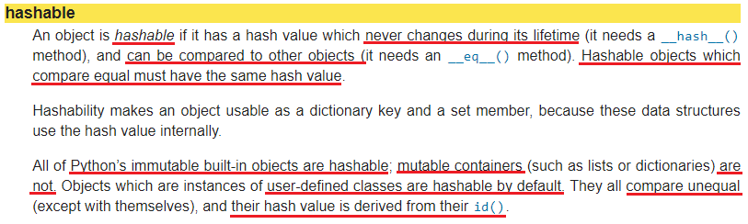
Hashable object

Slide 4
Object hashes
An object hash is a number that represents the value of the object
Can be obtained using the hash(object) method
The built-in hash calls the __hash__ method
This is possible if the object is hashable

Slide 5
Dictionaries
Allow to map a set of unique keys to values
Only hashable objects can be used as keys
Object is hashable:
If it has a hash value that never changes
Can be compared to others
Every built-in immutable object in Python is also hashable
Mutable types such as: list, dictionary, set are not hashables
Cannot be used as keys in dictionaries

Slide 6
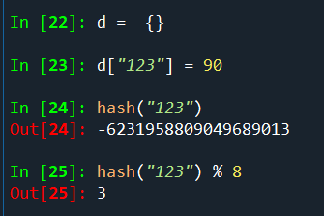
How does it work?
0
1
2
3
4
5
6
7

Slide 7
How does it work?
0
1
2
3
4
5
6
7
(“123”, 90, hash value)

Slide 8
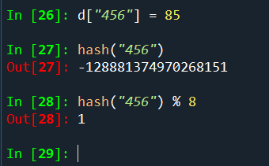
How does it work?
0
1
2
3
4
5
6
7
(“456”, 85, hash value)
(“123”, 90, hash value)

Slide 9
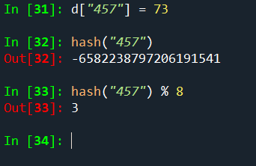
How does it work?
0
1
2
3
4
5
6
7
(“456”, 85, hash value)
collision
(“123”, 90, hash value)
Linear probing
(“457”, 73, hash value)

Slide 10
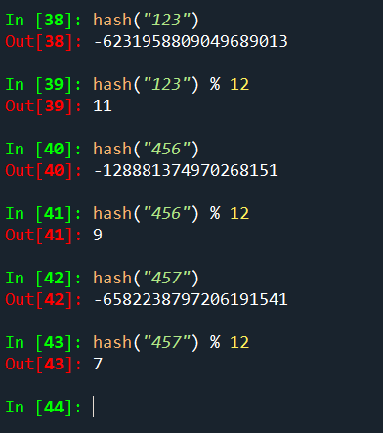
A larger table helps

Slide 11
A protocol that defines hashable objects
This protocol consists of two methods:
__hash__
method that returns a hash value
Default for user-defined classes is based on object id
__eq__
method that compares equality between two objects
Default for user-defined objects is false except comparing an object with itself.
Two objects that are compared to be equal MUST have the same hash value
The reverse does not need to be true

Slide 12
Object equality
You have to implement __eq__(self, other) method
Returns True if self is equal to other, False otherwise.
Raises an exception if __eq__ does not how to compare between self and other
Default behavior of __eq__ returns True just if you compare an object with itself.
Two objects with same content but different ids will yield False
Two references that point to the same object will yield True

Slide 13
Object equality
You have to implement __eq__(self, other) method
Returns True if self is equal to other, False otherwise.
Raises an exception if __eq__ does not how to compare between self and other
Default behavior of __eq__ returns True just if you compare an object with itself.
Two objects with same content but different ids will yield False
Two references that point to the same object will yield True

Slide 14
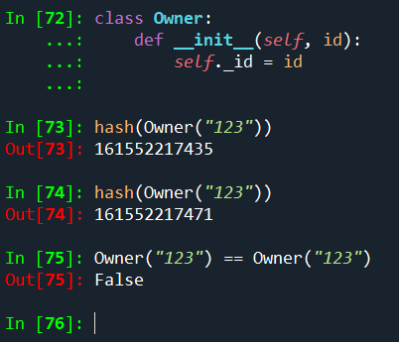
Making user-defined classes hashable
By default, they are hashable

Slide 15
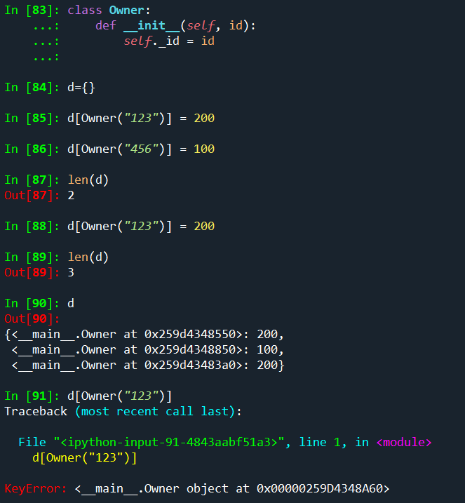
Making user-defined classes hashable

Slide 16
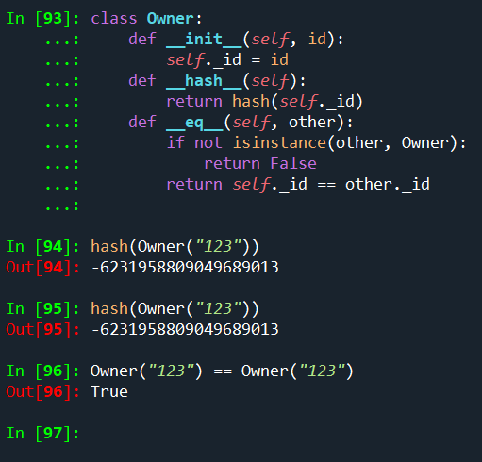
Making user-defined classes hashable

Slide 17
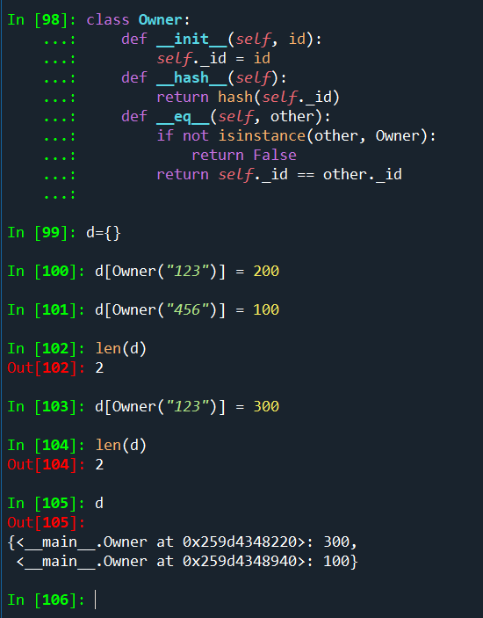
Making user-defined classes hashable

